Slide 1
AI for Medicine
Lecture 21:
Deep Learning – Part II
April 12, 2021
Mohammad Hammoud
Carnegie Mellon University in Qatar

Slide 2
Today…
Last Monday’s Session:
  Deep Learning – Part I
Today’s Session:
  Deep Learning – Part II
Announcements:
  Assignment 3 is due on Wednesday April 14 by midnight
  Quiz II is on April 19

Slide 3
Outline
Deep Learning
Overview
Vectorization
Computation Graph
Gradient Descent

Slide 4
The Flow of Computations in Neural Networks
The flow of computations in a neural network goes in two ways:
  Left-to-right: This is referred to as forward propagation, which results in computing the output of the network
  Right-to-left: This is referred to as back propagation, which results in computing the gradients (or derivatives) of the parameters in the network
The intuition behind this 2-way flow of computations can be explained through the concept of “computation graphs”
  What is a computation graph?

Slide 5

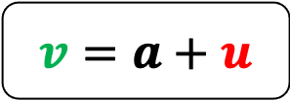















What is a Computation Graph?
Let us assume we want to compute the following function $J$:
$$J\left(a, b, c\right)=3(a+bc)$$
$$u=bc$$
$$u$$
$$v=a+u$$
$$v$$
$$J$$
$$J=3v$$
$$a=2$$
$$b=4$$
Computation
Graph
$$u=bc$$
$$v=a+u$$
$$J=3v$$
$$12$$
1$4$
$$42$$
$$c=3$$

Slide 6
Forward Propagation
Let us assume we want to compute the following function $J$:
$$J\left(a, b, c\right)=3(a+bc)$$
$$u=bc$$
$$u$$
$$v=a+u$$
$$v$$
$$J$$
$$J=3v$$
$$a=2$$
$$b=4$$
Computation
Graph
$$u=bc$$
$$v=a+u$$
$$J=3v$$
$$12$$
1$4$
$$42$$
$$c=3$$

Slide 7



Forward Propagation
Let us assume we want to compute the following function $J$:
$$J\left(a, b, c\right)=3(a+bc)$$
$$u=bc$$
$$u$$
$$v=a+u$$
$$v$$
$$J$$
$$J=3v$$
$$a=2$$
$$b=4$$
Computation
Graph
$$u=bc$$
$$v=a+u$$
$$J=3v$$
$$12$$
1$4$
$$42$$
$$c=3$$

Slide 8


Forward Propagation
Let us assume we want to compute the following function $J$:
$$J\left(a, b, c\right)=3(a+bc)$$
$$u=bc$$
$$u$$
$$v=a+u$$
$$v$$
$$J$$
$$J=3v$$
$$a=2$$
$$b=4$$
Computation
Graph
$$u=bc$$
$$v=a+u$$
$$J=3v$$
$$12$$
1$4$
$$42$$
$$c=3$$

Slide 9

Forward Propagation
Let us assume we want to compute the following function $J$:
$$J\left(a, b, c\right)=3(a+bc)$$
$$u=bc$$
$$u$$
$$v=a+u$$
$$v$$
$$J$$
$$J=3v$$
$$a=2$$
$$b=4$$
Computation
Graph
$$u=bc$$
$$v=a+u$$
$$J=3v$$
$$12$$
1$4$
$$42$$
$$c=3$$
Forward propagation allows computing $J$

Slide 10






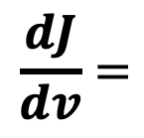




Backward Propagation
Let us now compute the derivatives of the variables through the computation graph as follows:
$$a=2$$
$$b=4$$
$$u=bc$$
$$v=a+u$$
$$J=3v$$
$$12$$
1$4$
$$42$$
$$c=3$$
$$\frac{dJ}{dv}=$$
Derivative of $J$with respect to $v$

Slide 11



Backward Propagation
Let us now compute the derivatives of the variables through the computation graph as follows:
$$a=2$$
$$b=4$$
$$u=bc$$
$$v=a+u$$
$$J=3v$$
$$12$$
1$4$
$$42$$
$$c=3$$
1$4.001$
$$42.003$$
$$\frac{dJ}{dv}=$$
If we change $v$ a little bit, how would $J$ change?

Slide 12
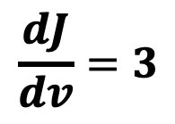
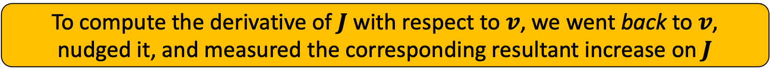
Backward Propagation
Let us now compute the derivatives of the variables through the computation graph as follows:
$$a=2$$
$$b=4$$
$$u=bc$$
$$v=a+u$$
$$J=3v$$
$$12$$
1$4$
$$42$$
$$c=3$$
1$4.001$
$$42.003$$
$$\frac{dJ}{dv}=3$$
To compute the derivative of $J$with respect to $v$, we went back to $v$,
nudged it, and measured the corresponding resultant increase on $J$

Slide 13

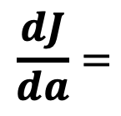
Backward Propagation
Let us now compute the derivatives of the variables through the computation graph as follows:
$$a=2$$
$$b=4$$
$$u=bc$$
$$v=a+u$$
$$J=3v$$
$$12$$
1$4$
$$42$$
$$c=3$$
$$\frac{dJ}{da}=$$
Derivative of $J$with respect to $a$

Slide 14


Backward Propagation
Let us now compute the derivatives of the variables through the computation graph as follows:
$$a=2$$
$$b=4$$
2$.001$
$$u=bc$$
$$v=a+u$$
$$J=3v$$
$$12$$
1$4$
$$42$$
$$c=3$$
1$4.001$
$$42.003$$
$$\frac{dJ}{da}=$$
If we change $a$ a little bit, how would $J$ change?

Slide 15
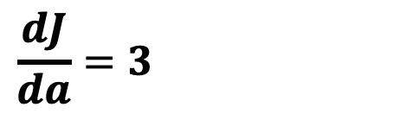
Backward Propagation
Let us now compute the derivatives of the variables through the computation graph as follows:
$$a=2$$
$$b=4$$
2$.001$
$$u=bc$$
$$v=a+u$$
$$J=3v$$
$$12$$
1$4$
$$42$$
$$c=3$$
1$4.001$
$$42.003$$
$$\frac{dJ}{da}=3=\frac{dJ}{dv} × \frac{dv}{da}$$

Slide 16
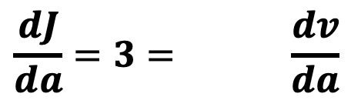

Backward Propagation
Let us now compute the derivatives of the variables through the computation graph as follows:
$$a=2$$
$$b=4$$
2$.001$
$$u=bc$$
$$v=a+u$$
$$J=3v$$
$$12$$
1$4$
$$42$$
$$c=3$$
1$4.001$
$$42.003$$
$$\frac{dJ}{da}=3=\frac{dJ}{dv} × \frac{dv}{da}$$
The change in $a$ caused a change in $v$

Slide 17
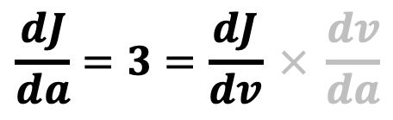

Backward Propagation
Let us now compute the derivatives of the variables through the computation graph as follows:
$$a=2$$
$$b=4$$
2$.001$
$$u=bc$$
$$v=a+u$$
$$J=3v$$
$$12$$
1$4$
$$42$$
$$c=3$$
1$4.001$
$$42.003$$
$$\frac{dJ}{da}=3=\frac{dJ}{dv} × \frac{dv}{da}$$
And the change in $v$ caused a change in $J$

Slide 18
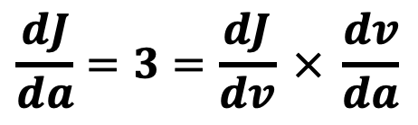
Backward Propagation
Let us now compute the derivatives of the variables through the computation graph as follows:
$$a=2$$
$$b=4$$
2$.001$
$$u=bc$$
$$v=a+u$$
$$J=3v$$
$$12$$
1$4$
$$42$$
$$c=3$$
1$4.001$
$$42.003$$
$$\frac{dJ}{da}=3=\frac{dJ}{dv} × \frac{dv}{da}$$
This is denoted as the chain rule in calculus

Slide 19
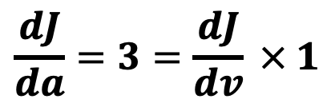
Backward Propagation
Let us now compute the derivatives of the variables through the computation graph as follows:
$$a=2$$
$$b=4$$
2$.001$
$$u=bc$$
$$v=a+u$$
$$J=3v$$
$$12$$
1$4$
$$42$$
$$c=3$$
1$4.001$
$$42.003$$
$$\frac{dJ}{da}=3=\frac{dJ}{dv} × 1$$

Slide 20

Backward Propagation
Let us now compute the derivatives of the variables through the computation graph as follows:
$$a=2$$
$$b=4$$
2$.001$
$$u=bc$$
$$v=a+u$$
$$J=3v$$
$$12$$
1$4$
$$42$$
$$c=3$$
1$4.001$
$$42.003$$
$$\frac{dJ}{da}=3=3 × 1$$

Slide 21
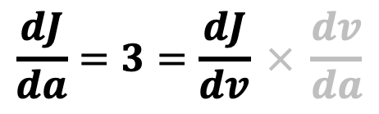
Backward Propagation
Let us now compute the derivatives of the variables through the computation graph as follows:
$$a=2$$
$$b=4$$
2$.001$
$$u=bc$$
$$v=a+u$$
$$J=3v$$
$$12$$
1$4$
$$42$$
$$c=3$$
1$4.001$
$$42.003$$
$$\frac{dJ}{da}=3=\frac{dJ}{dv} × \frac{dv}{da}$$
In essence, to compute the derivative of $J$with respect to $a$, we had to go back to $v$, nudge it a little bit, and measure the corresponding resultant increase on $J$

Slide 22

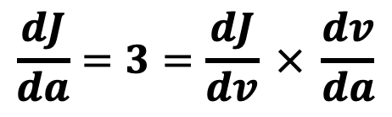
Backward Propagation
Let us now compute the derivatives of the variables through the computation graph as follows:
$$a=2$$
$$b=4$$
2$.001$
$$u=bc$$
$$v=a+u$$
$$J=3v$$
$$12$$
1$4$
$$42$$
$$c=3$$
1$4.001$
$$42.003$$
$$\frac{dJ}{da}=3=\frac{dJ}{dv} × \frac{dv}{da}$$
Then, we had to go back to $a$, nudge it a little bit, and measure the corresponding resultant increase on $v$

Slide 23
Backward Propagation
Let us now compute the derivatives of the variables through the computation graph as follows:
$$a=2$$
$$b=4$$
2$.001$
$$u=bc$$
$$v=a+u$$
$$J=3v$$
$$12$$
1$4$
$$42$$
$$c=3$$
1$4.001$
$$42.003$$
$$\frac{dJ}{da}=3=\frac{dJ}{dv} × \frac{dv}{da}$$
Then, we multiplied the changes together (i.e., we applied the chain rule!)

Slide 24

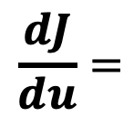
Backward Propagation
Let us now compute the derivatives of the variables through the computation graph as follows:
$$a=2$$
$$b=4$$
$$u=bc$$
$$v=a+u$$
$$J=3v$$
$$12$$
1$4$
$$42$$
$$c=3$$
$$\frac{dJ}{du}=$$
Derivative of $J$with respect to $u$

Slide 25


Backward Propagation
Let us now compute the derivatives of the variables through the computation graph as follows:
$$a=2$$
$$b=4$$
$$u=bc$$
$$v=a+u$$
$$J=3v$$
$$12$$
1$4$
$$42$$
$$c=3$$
12$.001$
1$4.001$
$$42.003$$
$$\frac{dJ}{du}=$$
If we change $u$ a little bit, how would $J$ change?

Slide 26

Backward Propagation
Let us now compute the derivatives of the variables through the computation graph as follows:
$$a=2$$
$$b=4$$
$$u=bc$$
$$v=a+u$$
$$J=3v$$
$$12$$
1$4$
$$42$$
$$c=3$$
12$.001$
1$4.001$
$$42.003$$
$$\frac{dJ}{du}=3=\frac{dJ}{dv}.\frac{dv}{da}$$

Slide 27
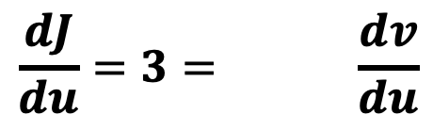

Backward Propagation
Let us now compute the derivatives of the variables through the computation graph as follows:
$$a=2$$
$$b=4$$
$$u=bc$$
$$v=a+u$$
$$J=3v$$
$$12$$
1$4$
$$42$$
$$c=3$$
12$.001$
1$4.001$
$$42.003$$
$$\frac{dJ}{du}=3=\frac{dJ}{dv} × \frac{dv}{du}$$
The change in $u$ caused a change in $v$

Slide 28
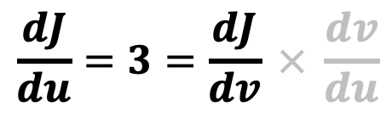
Backward Propagation
Let us now compute the derivatives of the variables through the computation graph as follows:
$$a=2$$
$$b=4$$
$$u=bc$$
$$v=a+u$$
$$J=3v$$
$$12$$
1$4$
$$42$$
$$c=3$$
12$.001$
1$4.001$
$$42.003$$
$$\frac{dJ}{du}=3=\frac{dJ}{dv} × \frac{dv}{du}$$
And the change in $v$ caused a change in $J$

Slide 29
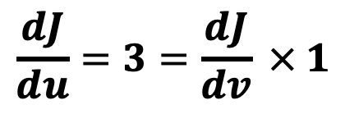
Backward Propagation
Let us now compute the derivatives of the variables through the computation graph as follows:
$$a=2$$
$$b=4$$
$$u=bc$$
$$v=a+u$$
$$J=3v$$
$$12$$
1$4$
$$42$$
$$c=3$$
12$.001$
1$4.001$
$$42.003$$
$$\frac{dJ}{du}=3=\frac{dJ}{dv} × 1$$

Slide 30

Backward Propagation
Let us now compute the derivatives of the variables through the computation graph as follows:
$$a=2$$
$$b=4$$
$$u=bc$$
$$v=a+u$$
$$J=3v$$
$$12$$
1$4$
$$42$$
$$c=3$$
12$.001$
1$4.001$
$$42.003$$
$$\frac{dJ}{du}=3=3 × 1$$

Slide 31
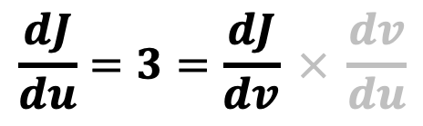
Backward Propagation
Let us now compute the derivatives of the variables through the computation graph as follows:
$$a=2$$
$$b=4$$
$$u=bc$$
$$v=a+u$$
$$J=3v$$
$$12$$
1$4$
$$42$$
$$c=3$$
12$.001$
1$4.001$
$$42.003$$
$$\frac{dJ}{du}=3=\frac{dJ}{dv} × \frac{dv}{du}$$

Slide 32
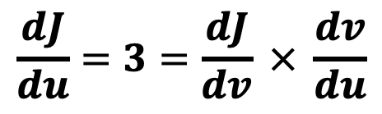
Backward Propagation
Let us now compute the derivatives of the variables through the computation graph as follows:
$$a=2$$
$$b=4$$
$$u=bc$$
$$v=a+u$$
$$J=3v$$
$$12$$
1$4$
$$42$$
$$c=3$$
12$.001$
1$4.001$
$$42.003$$
$$\frac{dJ}{du}=3=\frac{dJ}{dv} × \frac{dv}{du}$$
Same as before, we had to go back to $v$then to $u$ in order to compute the derivative of $J$

Slide 33

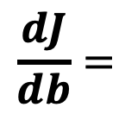
Backward Propagation
Let us now compute the derivatives of the variables through the computation graph as follows:
$$a=2$$
$$b=4$$
$$u=bc$$
$$v=a+u$$
$$J=3v$$
$$12$$
1$4$
$$42$$
$$c=3$$
$$\frac{dJ}{db}=$$
Derivative of $J$with respect to $b$

Slide 34

Backward Propagation
Let us now compute the derivatives of the variables through the computation graph as follows:
$$a=2$$
$$b=4$$
$$u=bc$$
$$v=a+u$$
$$J=3v$$
$$12$$
1$4$
$$42$$
$$c=3$$
$$\frac{dJ}{db}=$$
If we change $b$ a little bit, how would $J$ change?

Slide 35


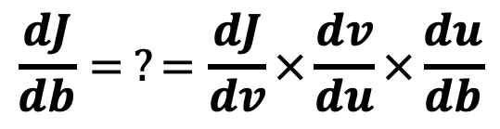


Backward Propagation
Let us now compute the derivatives of the variables through the computation graph as follows:
$$a=2$$
$$b=4$$
4$.001$
$$u=bc$$
$$v=a+u$$
$$J=3v$$
$$12$$
1$4$
$$42$$
$$c=3$$
12$.003$
1$4.003$
$$42.009$$
$$\frac{dJ}{db}= ?=\frac{dJ}{dv}×\frac{dv}{du}×\frac{du}{db}$$
3
1
3

Slide 36
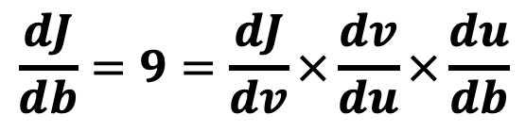
Backward Propagation
Let us now compute the derivatives of the variables through the computation graph as follows:
$$a=2$$
$$b=4$$
4$.001$
$$u=bc$$
$$v=a+u$$
$$J=3v$$
$$12$$
1$4$
$$42$$
$$c=3$$
12$.003$
1$4.003$
$$42.009$$
$$\frac{dJ}{db}=9=\frac{dJ}{dv}×\frac{dv}{du}×\frac{du}{db}$$
3
1
3

Slide 37
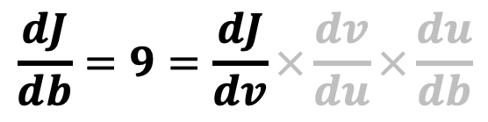
Backward Propagation
Let us now compute the derivatives of the variables through the computation graph as follows:
$$a=2$$
$$b=4$$
4$.001$
$$u=bc$$
$$v=a+u$$
$$J=3v$$
$$12$$
1$4$
$$42$$
$$c=3$$
12$.003$
1$4.003$
$$42.009$$
$$\frac{dJ}{db}=9=\frac{dJ}{dv}×\frac{dv}{du}×\frac{du}{db}$$
3
1
3

Slide 38
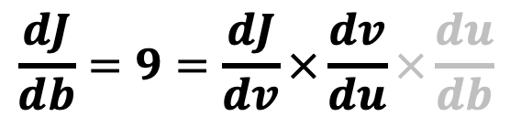
Backward Propagation
Let us now compute the derivatives of the variables through the computation graph as follows:
$$a=2$$
$$b=4$$
4$.001$
$$u=bc$$
$$v=a+u$$
$$J=3v$$
$$12$$
1$4$
$$42$$
$$c=3$$
12$.003$
1$4.003$
$$42.009$$
$$\frac{dJ}{db}=9=\frac{dJ}{dv}×\frac{dv}{du}×\frac{du}{db}$$
3
1
3

Slide 39

Backward Propagation
Let us now compute the derivatives of the variables through the computation graph as follows:
$$a=2$$
$$b=4$$
4$.001$
$$u=bc$$
$$v=a+u$$
$$J=3v$$
$$12$$
1$4$
$$42$$
$$c=3$$
12$.003$
1$4.003$
$$42.009$$
$$\frac{dJ}{db}=9=\frac{dJ}{dv}×\frac{dv}{du}×\frac{du}{db}$$
3
1
3

Slide 40

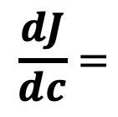
Backward Propagation
Let us now compute the derivatives of the variables through the computation graph as follows:
$$a=2$$
$$b=4$$
$$u=bc$$
$$v=a+u$$
$$J=3v$$
$$12$$
1$4$
$$42$$
$$c=3$$
$$\frac{dJ}{dc}=$$
Derivative of $J$with respect to $c$

Slide 41

Backward Propagation
Let us now compute the derivatives of the variables through the computation graph as follows:
$$a=2$$
$$b=4$$
$$u=bc$$
$$v=a+u$$
$$J=3v$$
$$12$$
1$4$
$$42$$
$$c=3$$
$$\frac{dJ}{dc}=$$
If we change $c$ a little bit, how would $J$ change?

Slide 42


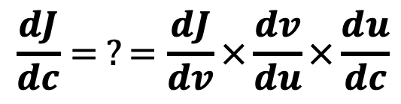


Backward Propagation
Let us now compute the derivatives of the variables through the computation graph as follows:
$$a=2$$
$$b=4$$
$$u=bc$$
$$v=a+u$$
$$J=3v$$
$$12$$
1$4$
$$42$$
$$c=3$$
3$.001$
12$.004$
1$4.004$
$$42.012$$
$$\frac{dJ}{dc}= ?=\frac{dJ}{dv}×\frac{dv}{du}×\frac{du}{dc}$$
3
1
4

Slide 43
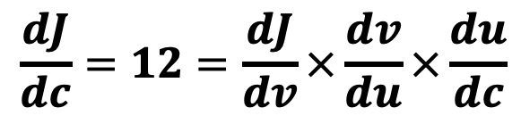
Backward Propagation
Let us now compute the derivatives of the variables through the computation graph as follows:
$$a=2$$
$$b=4$$
$$u=bc$$
$$v=a+u$$
$$J=3v$$
$$12$$
1$4$
$$42$$
$$c=3$$
3$.001$
12$.004$
1$4.004$
$$42.012$$
$$\frac{dJ}{dc}=12=\frac{dJ}{dv}×\frac{dv}{du}×\frac{du}{dc}$$
3
1
4

Slide 44
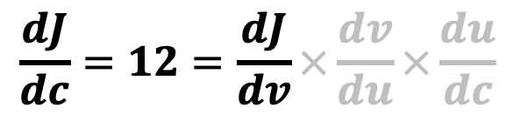
Backward Propagation
Let us now compute the derivatives of the variables through the computation graph as follows:
$$a=2$$
$$b=4$$
$$u=bc$$
$$v=a+u$$
$$J=3v$$
$$12$$
1$4$
$$42$$
$$c=3$$
3$.001$
12$.004$
1$4.004$
$$42.012$$
$$\frac{dJ}{dc}=12=\frac{dJ}{dv}×\frac{dv}{du}×\frac{du}{dc}$$
3
1
4

Slide 45
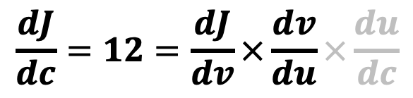
Backward Propagation
Let us now compute the derivatives of the variables through the computation graph as follows:
$$a=2$$
$$b=4$$
$$u=bc$$
$$v=a+u$$
$$J=3v$$
$$12$$
1$4$
$$42$$
$$c=3$$
3$.001$
12$.004$
1$4.004$
$$42.012$$
$$\frac{dJ}{dc}=12=\frac{dJ}{dv}×\frac{dv}{du}×\frac{du}{dc}$$
3
1
4

Slide 46
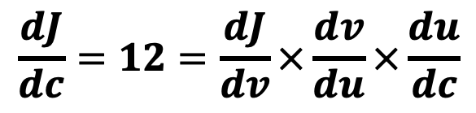
Backward Propagation
Let us now compute the derivatives of the variables through the computation graph as follows:
$$a=2$$
$$b=4$$
$$u=bc$$
$$v=a+u$$
$$J=3v$$
$$12$$
1$4$
$$42$$
$$c=3$$
3$.001$
12$.004$
1$4.004$
$$42.012$$
$$\frac{dJ}{dc}=12=\frac{dJ}{dv}×\frac{dv}{du}×\frac{du}{dc}$$
3
1
4

Slide 47
Outline
Deep Learning
Overview
Vectorization
Computation Graph
Gradient Descent

Slide 48




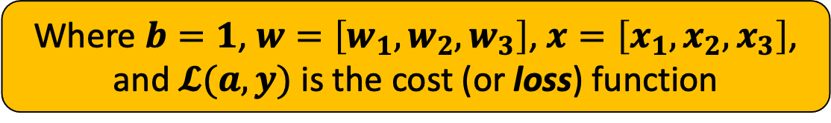









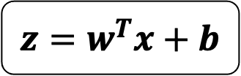





The Computation Graph of Logistic Regression
Let us translate logistic regression (which is a neural network with only 1 neuron) into a computation graph
$$1$$
$$b$$
$$z=w^{T}x+b$$
$$x_{1}$$
$$w_{1}$$
$$b$$
$$x_{2}$$
$$w_{2}$$
$$\hat{y}$$
$$x$$
$$z=w^{T}x+b$$
$$a=σ(z)$$
$$𝓛(a,y)$$
$$z$$
$$a$$
$$w_{3}$$
$$w$$
$$x_{3}$$
$$a=σ(z)$$
Where $b=1$, $w=\left[w_{1},w_{2},w_{3}\right]$, $x=\left[x_{1},x_{2},x_{3}\right]$, and $𝓛(a,y)$ is the cost (or loss) function

Slide 49
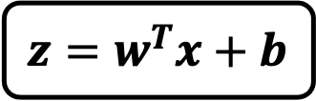

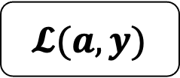
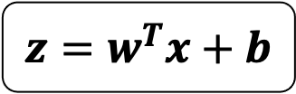


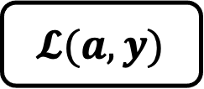

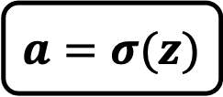
Forward Propagation
The loss function can be computed by moving from left to right
$$b$$
$$z=w^{T}x+b$$
$$𝓛(a,y)$$
$$z=w^{T}x+b$$
$$a=σ(z)$$
$$𝓛(a,y)$$
$$x$$
$$a=σ(z)$$
$$w$$

Slide 50
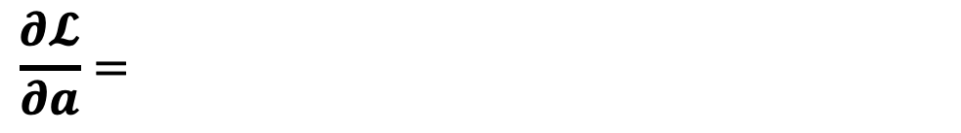

Backward Propagation
The derivatives can be computed by moving from right to left
$$b$$
$$x$$
$$z=w^{T}x+b$$
$$a=σ(z)$$
$$𝓛(a,y)$$
$$w$$
$$\frac{∂𝓛}{∂a}=\frac{∂}{∂a}\left(−ylog\left(a\right)−\left(1−y\right)log\left(1−a\right)\right)$$
Partial derivative of $𝓛$ with respect to $a$

Slide 51
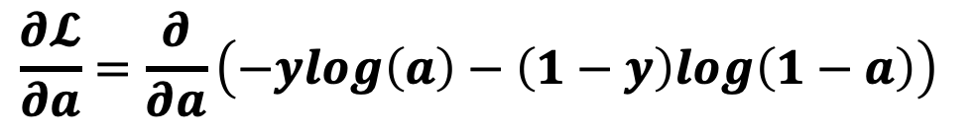
Backward Propagation
The derivatives can be computed by moving from right to left
$$b$$
$$x$$
$$z=w^{T}x+b$$
$$a=σ(z)$$
$$𝓛(a,y)$$
$$w$$
$$\frac{∂𝓛}{∂a}=\frac{∂}{∂a}\left(−ylog\left(a\right)−\left(1−y\right)log\left(1−a\right)\right)$$

Slide 52
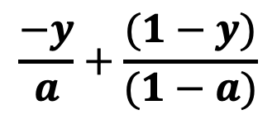
Backward Propagation
The derivatives can be computed by moving from right to left
$$b$$
$$x$$
$$z=w^{T}x+b$$
$$a=σ(z)$$
$$𝓛(a,y)$$
$$w$$
$$\frac{−y}{a}+\frac{(1−y)}{(1−a)}$$
$$\frac{∂𝓛}{∂a}=\frac{∂}{∂a}\left(−ylog\left(a\right)−\left(1−y\right)log\left(1−a\right)\right)$$

Slide 53
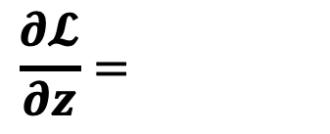

Backward Propagation
The derivatives can be computed by moving from right to left
$$b$$
$$x$$
$$z=w^{T}x+b$$
$$a=σ(z)$$
$$𝓛(a,y)$$
$$w$$
$$\frac{∂𝓛}{∂z}=\frac{∂𝓛}{∂a}×\frac{∂a}{∂z}$$
Partial derivative of $𝓛$ with respect to $z$

Slide 54
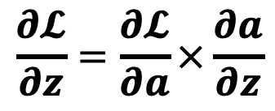
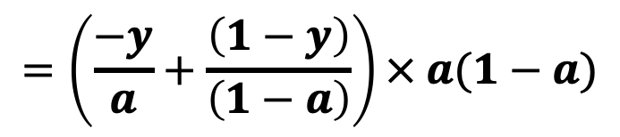

Backward Propagation
The derivatives can be computed by moving from right to left
$$b$$
$$x$$
$$z=w^{T}x+b$$
$$a=σ(z)$$
$$𝓛(a,y)$$
$$w$$
$$\frac{∂𝓛}{∂z}=\frac{∂𝓛}{∂a}×\frac{∂a}{∂z}$$
$$=\left(\frac{−y}{a}+\frac{\left(1−y\right)}{\left(1−a\right)}\right)×\frac{∂a}{∂z}$$
$$=\left(\frac{−y}{a}+\frac{\left(1−y\right)}{\left(1−a\right)}\right)× a(1−a)$$

Slide 55

Backward Propagation
The derivatives can be computed by moving from right to left
$$b$$
$$x$$
$$z=w^{T}x+b$$
$$a=σ(z)$$
$$𝓛(a,y)$$
$$w$$
$$\frac{∂𝓛}{∂z}=\frac{∂𝓛}{∂a}×\frac{∂a}{∂z}$$
$$a−y$$

Slide 56


Backward Propagation
The derivatives can be computed by moving from right to left
$$b$$
$$x$$
$$z=w^{T}x+b$$
$$a=σ(z)$$
$$𝓛(a,y)$$
$$w$$
$$\frac{∂𝓛}{∂b}=\frac{∂𝓛}{∂a}×\frac{∂a}{∂z}×\frac{∂z}{∂b}$$
Partial derivative of $𝓛$ with respect to $b$

Slide 57




Backward Propagation
The derivatives can be computed by moving from right to left
$$b$$
$$x$$
$$z=w^{T}x+b$$
$$a=σ(z)$$
$$𝓛(a,y)$$
$$w$$
$$\frac{∂𝓛}{∂b}=\frac{∂𝓛}{∂a}×\frac{∂a}{∂z}×\frac{∂z}{∂b}$$
$$=(a−y) ×\frac{∂z}{∂b}$$
$$=(a−y) ×1$$
$$=(a−y)$$

Slide 58


Backward Propagation
The derivatives can be computed by moving from right to left
$$b$$
$$x$$
$$z=w^{T}x+b$$
$$a=σ(z)$$
$$𝓛(a,y)$$
$$w$$
$$\frac{∂𝓛}{∂w}=\frac{∂𝓛}{∂a}×\frac{∂a}{∂z}×\frac{∂z}{∂w}$$
Partial derivative of $𝓛$ with respect to $w$

Slide 59



Backward Propagation
The derivatives can be computed by moving from right to left
$$b$$
$$x$$
$$z=w^{T}x+b$$
$$a=σ(z)$$
$$𝓛(a,y)$$
$$w$$
$$\frac{∂𝓛}{∂w}=\frac{∂𝓛}{∂a}×\frac{∂a}{∂z}×\frac{∂z}{∂w}$$
$$=(a−y) ×\frac{∂z}{∂w}$$
$$=(a−y)x$$

Slide 60
Next Monday’s Lecture…
Deep Learning
Overview
Vectorization
Computation Graph
Gradient Descent
Continue…

